Slide 1
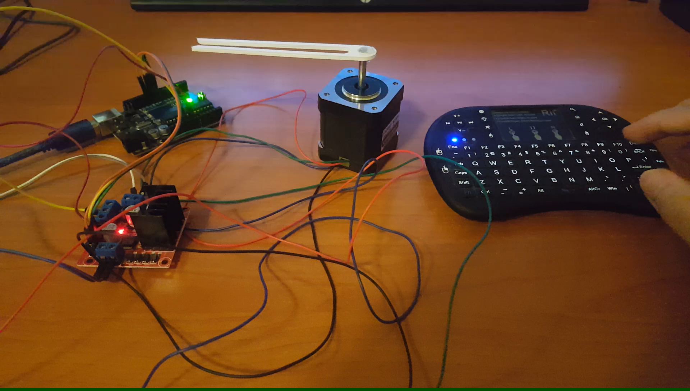
Methodology to Test the System

